Slide 1

How to use the UoN HPC “Ada”
LIFE4138

Slide 2
First lets all get logged in and pull the github repo to Ada
ssh ada
git clone https://github.com/BioinformaticsMSc/LIFE4138_2526.git

Slide 3
Learning Objectives
Know how to write a job submission script
Know how to submit and manage a job using basic slurm commands
Know how to request an interactive job
Know how to access software on the HPC
Know how to copy files between the HPC and your local machine
Know where to go for further support

Slide 4

SLURM – Simple Linux Utility for Resource Management
https://slurm.schedmd.com/documentation.html
Notes:
SLURM – Simple Linux Utility for Resource Management.
The software we use to run our HPC.
This is one reason why you need to be competent Unix users!

Slide 5
How to use Ada
ssh to login to a login node
submit jobs to compute nodes
OR
srun for interactive job on compute node
OR
OpenOnDemand – vnc session: super useful if you want to use a GUI (graphical user interface)
1
Major bonus, you can logout of Ada and your job is still running
2
3

Slide 6
Every job needs a job submission script:
Example job submission script:
#!/bin/bash
#SBATCH --partition=defq
#SBATCH --nodes=1
#SBATCH --ntasks=1
#SBATCH --cpus-per-task=8
#SBATCH --mem=5g
#SBATCH --time=00:10:00
#SBATCH --job-name=my_job
#SBATCH --output=/gpfs01/home/mbzlld/slurm-%x-%j.out
#SBATCH --error=/gpfs01/home/mbzlld/slurm-%x-%j.err
#SBATCH --mail-type=ALL
#SBATCH --mail-user=mbzlld@exmail.nottingham.ac.uk
# Write out a test file to check our job ran
echo “hello world” > ~/our_test_output.txt
NOTE: My username is mbzlld – where you see this in the scripts you will need to replace it with your own university username

Slide 7
Every job needs a job submission script:
Example job submission script:
#!/bin/bash
#SBATCH --partition=defq
#SBATCH --nodes=1
#SBATCH --ntasks=1
#SBATCH --cpus-per-task=8
#SBATCH --mem=5g
#SBATCH --time=00:10:00
#SBATCH --job-name=my_job
#SBATCH --output=/gpfs01/home/mbzlld/slurm-%x-%j.out
#SBATCH --error=/gpfs01/home/mbzlld/slurm-%x-%j.err
#SBATCH --mail-type=ALL
#SBATCH --mail-user=mbzlld@exmail.nottingham.ac.uk
# Write out a test file to check our job ran
echo “hello world” > ~/our_test_output.txt
#!/bin/bash
The shebang – tells the operating system which interpreter to use to when executing the script
NOTE: My username is mbzlld – where you see this in the scripts you will need to replace it with your own university username

Slide 8
Every job needs a job submission script:
Example job submission script:
#!/bin/bash
#SBATCH --partition=defq
#SBATCH --nodes=1
#SBATCH --ntasks=1
#SBATCH --cpus-per-task=8
#SBATCH --mem=5g
#SBATCH --time=00:10:00
#SBATCH --job-name=my_job
#SBATCH --output=/gpfs01/home/mbzlld/slurm-%x-%j.out
#SBATCH --error=/gpfs01/home/mbzlld/slurm-%x-%j.err
#SBATCH --mail-type=ALL
#SBATCH --mail-user=mbzlld@exmail.nottingham.ac.uk
# Write out a test file to check our job ran
echo “hello world” > ~/our_test_output.txt
--partition=
Select the type of compute node you want to use (we will talk about the different partitions that are available to you later)
NOTE: My username is mbzlld – where you see this in the scripts you will need to replace it with your own university username

Slide 9
Every job needs a job submission script:
Example job submission script:
#!/bin/bash
#SBATCH --partition=defq
#SBATCH --nodes=1
#SBATCH --ntasks=1
#SBATCH --cpus-per-task=8
#SBATCH --mem=5g
#SBATCH --time=00:10:00
#SBATCH --job-name=my_job
#SBATCH --output=/gpfs01/home/mbzlld/slurm-%x-%j.out
#SBATCH --error=/gpfs01/home/mbzlld/slurm-%x-%j.err
#SBATCH --mail-type=ALL
#SBATCH --mail-user=mbzlld@exmail.nottingham.ac.uk
# Write out a test file to check our job ran
echo “hello world” > ~/our_test_output.txt
--nodes=
Select how many compute nodes you want to use (almost always this will be 1)
NOTE: My username is mbzlld – where you see this in the scripts you will need to replace it with your own university username

Slide 10
Every job needs a job submission script:
Example job submission script:
#!/bin/bash
#SBATCH --partition=defq
#SBATCH --nodes=1
#SBATCH --ntasks=1
#SBATCH --cpus-per-task=8
#SBATCH --mem=5g
#SBATCH --time=00:10:00
#SBATCH --job-name=my_job
#SBATCH --output=/gpfs01/home/mbzlld/slurm-%x-%j.out
#SBATCH --error=/gpfs01/home/mbzlld/slurm-%x-%j.err
#SBATCH --mail-type=ALL
#SBATCH --mail-user=mbzlld@exmail.nottingham.ac.uk
# Write out a test file to check our job ran
echo “hello world” > ~/our_test_output.txt
--ntasks=
Select how many separate tasks you want your job to be split across (for most jobs this will also be 1)
NOTE: My username is mbzlld – where you see this in the scripts you will need to replace it with your own university username

Slide 11
Every job needs a job submission script:
Example job submission script:
#!/bin/bash
#SBATCH --partition=defq
#SBATCH --nodes=1
#SBATCH --ntasks=1
#SBATCH --cpus-per-task=8
#SBATCH --mem=5g
#SBATCH --time=00:10:00
#SBATCH --job-name=my_job
#SBATCH --output=/gpfs01/home/mbzlld/slurm-%x-%j.out
#SBATCH --error=/gpfs01/home/mbzlld/slurm-%x-%j.err
#SBATCH --mail-type=ALL
#SBATCH --mail-user=mbzlld@exmail.nottingham.ac.uk
# Write out a test file to check our job ran
echo “hello world” > ~/our_test_output.txt
--cpus-per-task=
Select how many cores you want your job to use. This is where you can make a lot of things much faster by requesting more cores.
NOTE: you cannot request more than the maximum number of cores in the node or nodes you have requested.
NOTE: My username is mbzlld – where you see this in the scripts you will need to replace it with your own university username

Slide 12
Every job needs a job submission script:
Example job submission script:
#!/bin/bash
#SBATCH --partition=defq
#SBATCH --nodes=1
#SBATCH --ntasks=1
#SBATCH --cpus-per-task=8
#SBATCH --mem=5g
#SBATCH --time=00:10:00
#SBATCH --job-name=my_job
#SBATCH --output=/gpfs01/home/mbzlld/slurm-%x-%j.out
#SBATCH --error=/gpfs01/home/mbzlld/slurm-%x-%j.err
#SBATCH --mail-type=ALL
#SBATCH --mail-user=mbzlld@exmail.nottingham.ac.uk
# Write out a test file to check our job ran
echo “hello world” > ~/our_test_output.txt
--mem=
Select how much RAM to allocate to your job. This allows you to use far more memory than you would usually be able to access on a standard computer.
Units:
g = gb – gigabytes
m = mb – megabytes
NOTE: My username is mbzlld – where you see this in the scripts you will need to replace it with your own university username

Slide 13
Every job needs a job submission script:
Example job submission script:
#!/bin/bash
#SBATCH --partition=defq
#SBATCH --nodes=1
#SBATCH --ntasks=1
#SBATCH --cpus-per-task=8
#SBATCH --mem=5g
#SBATCH --time=00:10:00
#SBATCH --job-name=my_job
#SBATCH --output=/gpfs01/home/mbzlld/slurm-%x-%j.out
#SBATCH --error=/gpfs01/home/mbzlld/slurm-%x-%j.err
#SBATCH --mail-type=ALL
#SBATCH --mail-user=mbzlld@exmail.nottingham.ac.uk
# Write out a test file to check our job ran
echo “hello world” > ~/our_test_output.txt
--time=
Select the maximum amount of time your job can run for.
Units:
hh:mm:ss
NOTE: the different nodes have different maximum job times. No one can request more than 7 days (168 hours) on any node.
NOTE: My username is mbzlld – where you see this in the scripts you will need to replace it with your own university username

Slide 14
Every job needs a job submission script:
Example job submission script:
#!/bin/bash
#SBATCH --partition=defq
#SBATCH --nodes=1
#SBATCH --ntasks=1
#SBATCH --cpus-per-task=8
#SBATCH --mem=5g
#SBATCH --time=00:10:00
#SBATCH --job-name=my_job
#SBATCH --output=/gpfs01/home/mbzlld/slurm-%x-%j.out
#SBATCH --error=/gpfs01/home/mbzlld/slurm-%x-%j.err
#SBATCH --mail-type=ALL
#SBATCH --mail-user=mbzlld@exmail.nottingham.ac.uk
# Write out a test file to check our job ran
echo “hello world” > ~/our_test_output.txt
--job-name=
Short useful name for you to identify your job (no spaces allowed!)
NOTE: My username is mbzlld – where you see this in the scripts you will need to replace it with your own university username

Slide 15
Every job needs a job submission script:
Example job submission script:
#!/bin/bash
#SBATCH --partition=defq
#SBATCH --nodes=1
#SBATCH --ntasks=1
#SBATCH --cpus-per-task=8
#SBATCH --mem=5g
#SBATCH --time=00:10:00
#SBATCH --job-name=my_job
#SBATCH --output=/gpfs01/home/mbzlld/slurm-%x-%j.out
#SBATCH --error=/gpfs01/home/mbzlld/slurm-%x-%j.err
#SBATCH --mail-type=ALL
#SBATCH --mail-user=mbzlld@exmail.nottingham.ac.uk
# Write out a test file to check our job ran
echo “hello world” > ~/our_test_output.txt
--output=
Name and location of output file (all output that would be printed to the screen if you ran your script directly in the terminal will be stored here)
If you do not specify a separate error file, errors will also be written to your output file.
%x = Job name (taken from --job-name=)
%j = Job ID (allocated upon submission)
Note: you cannot use ~ as shorthand for your home directory here
NOTE: My username is mbzlld – where you see this in the scripts you will need to replace it with your own university username

Slide 16
Every job needs a job submission script:
Example job submission script:
#!/bin/bash
#SBATCH --partition=defq
#SBATCH --nodes=1
#SBATCH --ntasks=1
#SBATCH --cpus-per-task=8
#SBATCH --mem=5g
#SBATCH --time=00:10:00
#SBATCH --job-name=my_job
#SBATCH --output=/gpfs01/home/mbzlld/slurm-%x-%j.out
#SBATCH --error=/gpfs01/home/mbzlld/slurm-%x-%j.err
#SBATCH --mail-type=ALL
#SBATCH --mail-user=mbzlld@exmail.nottingham.ac.uk
# Write out a test file to check our job ran
echo “hello world” > ~/our_test_output.txt
--error=
OPTIONAL: Name and location of error file (any errors that would be printed to the screen if you ran your script directly in the terminal will be stored here)
If you do not specify a separate error file, errors will be written to your output file.
%x = Job name (taken from --job-name=)
%j = Job ID (allocated upon submission)
Note: you cannot use ~ as shorthand for your home directory here
NOTE: My username is mbzlld – where you see this in the scripts you will need to replace it with your own university username

Slide 17
Every job needs a job submission script:
Example job submission script:
#!/bin/bash
#SBATCH --partition=defq
#SBATCH --nodes=1
#SBATCH --ntasks=1
#SBATCH --cpus-per-task=8
#SBATCH --mem=5g
#SBATCH --time=00:10:00
#SBATCH --job-name=my_job
#SBATCH --output=/gpfs01/home/mbzlld/slurm-%x-%j.out
#SBATCH --error=/gpfs01/home/mbzlld/slurm-%x-%j.err
#SBATCH --mail-type=ALL
#SBATCH --mail-user=mbzlld@exmail.nottingham.ac.uk
# Write out a test file to check our job ran
echo “hello world” > ~/our_test_output.txt
--mail-type=ALL
--mail-user=
OPTIONAL: include both these lines and replace my username with yours if you want the system to send you an email when your job starts running and when it completes.
NOTE: My username is mbzlld – where you see this in the scripts you will need to replace it with your own university username

Slide 18
Every job needs a job submission script:
Example job submission script:
#!/bin/bash
#SBATCH --partition=defq
#SBATCH --nodes=1
#SBATCH --ntasks=1
#SBATCH --cpus-per-task=8
#SBATCH --mem=5g
#SBATCH --time=00:10:00
#SBATCH --job-name=my_job
#SBATCH --output=/gpfs01/home/mbzlld/slurm-%x-%j.out
#SBATCH --error=/gpfs01/home/mbzlld/slurm-%x-%j.err
#SBATCH --mail-type=ALL
#SBATCH --mail-user=mbzlld@exmail.nottingham.ac.uk
# Write out a test file to check our job ran
echo “hello world” > ~/our_test_output.txt
The main body of your script – the bit where you write what you want the script to do.
NOTE: My username is mbzlld – where you see this in the scripts you will need to replace it with your own university username

Slide 19
Write your own:
Use your preferred text editor to create a file named: my_script and type the text below into your file
#!/bin/bash
#SBATCH --partition=defq
#SBATCH --nodes=1
#SBATCH --ntasks=1
#SBATCH --cpus-per-task=1
#SBATCH --mem=1g
#SBATCH --time=00:05:00
#SBATCH --job-name=my_job
#SBATCH --output=/gpfs01/home/mbzlld/slurm-%x-%j.out
#SBATCH --error=/gpfs01/home/mbzlld/slurm-%x-%j.err
#SBATCH --mail-type=ALL
#SBATCH --mail-user=mbzlld@exmail.nottingham.ac.uk
# Write out a test file to check our job ran
echo “hello world” > ~/our_test_output.txt
NOTE: My username is mbzlld – where you see this in the scripts you will need to replace it with your own university username

Slide 20

UoN HPC – Ada – SLURM commands:
sbatch - to submit a job
squeue - to list jobs, and show status
scancel - to delete jobs
sinfo - to show status of nodes and partitions
sacct - to output resource information on jobs
srun – to request an interactive session on a compute node

Slide 21
How to submit and monitor your script:
Submit your job script using the command:
sbatch my_script
Monitor your job using the command:
squeue –l –u username
Cancel your job using the command:
scancel job_id_number
(NOTE: the jobid number is in the first column of the output from squeue)

Slide 22
UoN HPC – Ada – ‘reasonlist’ for pending jobs
> squeue –l –u username
REASON | Description
Resources | All suitable resources are in use
Priority | There are higher priority jobs in queue
AssocGrpCPULimit | The maximum number of CPU cores allowed for running jobs has been reached
QOSMinMemory | The memory has not been defined, or has been set too low with '--mem' option
QOSNotAllowed | An inappropriate partition has been selected
ReqNodeNotAvail | Nodes are not available to run jobs. This may mean there is scheduled maintenance time in the near future

Slide 23
How to use Ada
ssh to login to a login node
submit jobs to compute nodes
OR
srun for interactive job on compute node
OR
OpenOnDemand – vnc session: super useful if you want to use a GUI (graphical user interface)
1
2
3

Slide 24
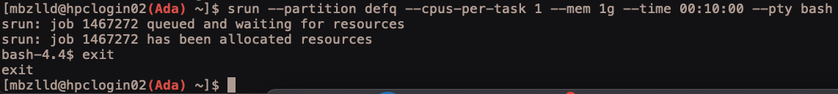
Using srun for an interactive session
(Options mostly similar to the sbatch command) NOTE: syntax difference, no = between flag and input
srun --partition defq --cpus-per-task 1 --mem 1g --time 00:10:00 --pty bash
Partition you would like to use
Number of cores you are requesting for your job
Amount of memory you are requesting for your job
Maximum runtime for your job
Type of shell to run your job in
Example srun usage:

Slide 25
How to use Ada
ssh to login to a login node
submit jobs to compute nodes
OR
srun for interactive job on compute node
OR
OpenOnDemand – vnc session: super useful if you want to use a GUI (graphical user interface)
1
2
3

Slide 26
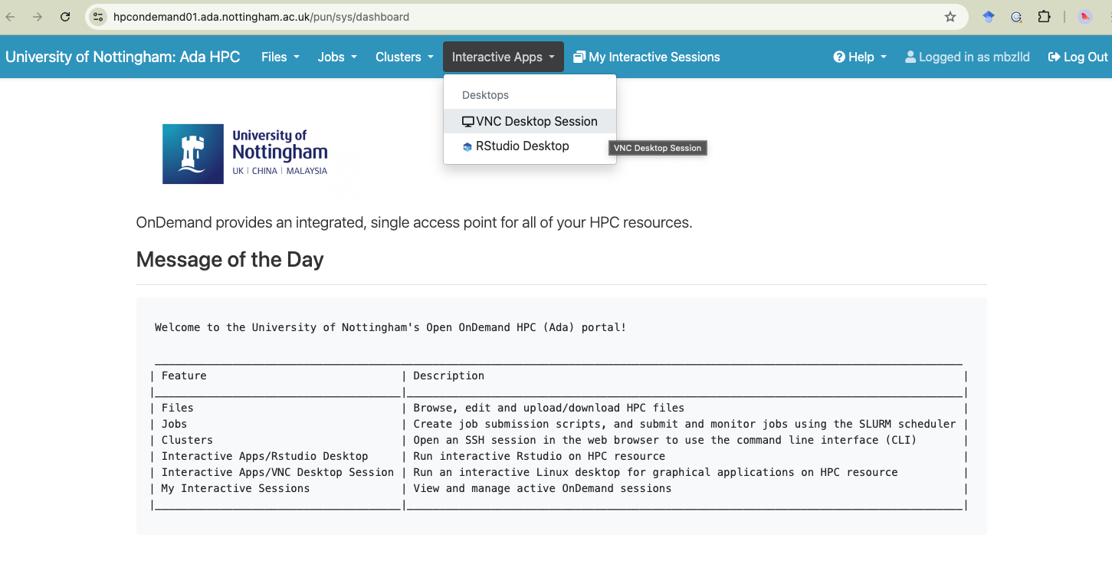
OpenOnDemand
https://hpcondemand01.ada.nottingham.ac.uk

Slide 27
Partitions on Ada:
Example job submission script:
#!/bin/bash
#SBATCH --partition=defq
#SBATCH --nodes=1
#SBATCH --ntasks=1
#SBATCH --cpus-per-task=8
#SBATCH --mem=5g
#SBATCH --time=00:10:00
#SBATCH --job-name=my_job
#SBATCH --output=/gpfs01/home/mbzlld/slurm-%x-%j.out
#SBATCH --error=/gpfs01/home/mbzlld/slurm-%x-%j.err
#SBATCH --mail-type=ALL
#SBATCH --mail-user=mbzlld@exmail.nottingham.ac.uk
# Write out a test file to check our job ran
echo “hello world” > ~/our_test_output.txt
--partition=
Select the type of compute node you want to use (we will talk about the different partitions that are available to you later)
NOTE: My username is mbzlld – where you see this in the scripts you will need to replace it with your own university username

Slide 28
UoN HPC – Ada – partitions:
Partition name | Type of node
defq | Standard compute nodes with 96 cores and 384 GB (361 GB usable) memory. There are 63 nodes in this partition. The maximum job walltime allowed is 7 days (168 hours).
shortq | Standard compute nodes with 96 cores and 384 GB (361 GB usable) memory. There are 6 nodes in this partition. The maximum job walltime allowed is 12 hours.
devq | Standard compute nodes with 96 cores and 384 GB (361 GB usable) memory. This queue shares the nodes with 'defq' partition, but limits total number of cores per user to 96, and number of jobs to 4. The maximum job walltime allowed is 1 hour.
hmemq | High memory compute node with 96 cores and 1536 GB (1495 GB usable) memory. There are 10 nodes in this partition. The maximum job walltime allowed is 7 days (168 hours).
ampereq | GPGPU (ampere) compute node with 96 cores and 768 GB (747 GB usable) memory, and 8 Nvidia A100 GPUs There are 2 nodes in this partition. The maximum job walltime allowed is 7 days (168 hours).
ampere-devq | GPGPU (ampere) compute node with 96 cores and 768 GB (747 GB usable) memory, and 8 Nvidia A100 GPUs This queue shares the nodes with 'ampereq' partition, but limits total number of cores per user to 12, number of GPUs per user to 1, and number of jobs to 4. The maximum job walltime allowed is 1 hour
ampere-mq | GPGPU (ampere) compute node with 96 cores and 768 GB (747 GB usable) memory, and 8 Nvidia A100 GPUs, each A100 split into 7x 'MIG' instances There are 2 nodes in this partition. The maximum job walltime allowed is 7 days (168 hours).
ampere-m-devq | GPGPU (ampere) compute node with 96 cores and 768 GB (747 GB usable) memory, and 8 Nvidia A100 GPUs, each A100 split into 7x 'MIG' instances This queue shares the nodes with 'ampere-mq' partition, but limits total number of cores per user to 12, number of GPUs per user to 1, and number of jobs to 4. The maximum job walltime allowed is 1 hour.
normal jobs
quick jobs
testing
high memory
GPU (graphics processing unit)
GPU - testing
Notes:
Defq is the one for accessing normal HPC nodes. This is probably the main queue you will want to use
If you need to run jobs with more than 361 GB memory e.g. genome assemblies you would use hmemq
If you want access to GPU nodes use ampere
GPU – graphics processing Unit

Slide 29

Accessing software on Ada
Pre-installed software available to you as modules
Software you install yourself with Conda
Software containers (singularity, docker) – we will not cover software containers in this module but you should be aware that they exist and you can use them on Ada

Slide 30
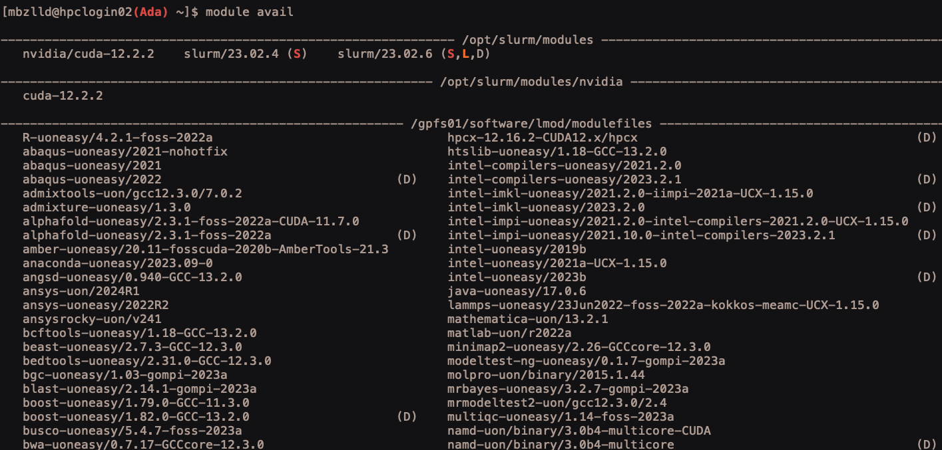
UoN HPC – Ada – software modules
TO SEE ALL AVAILABLE SOFTWARE module avail e.g.:
sticky
loaded
default
And many more…
Notes:
Software on Ada must be loaded from environment modules
To list all available software use module avail
S by a module means the module is sticky and requires the –force flag to unload (you shouldn’t need to mess with these!
L by a module means the module is currently loaded
D by a module means this is the default version of the software

Slide 31
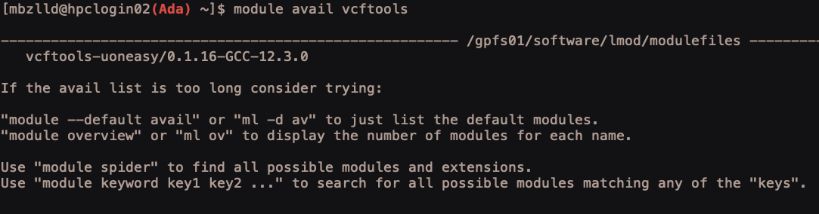
UoN HPC – Ada – software modules
TO SEARCH FOR SOFTWARE module avail software_name e.g.:
TO LOAD SOFTWARE: module load module_name e.g. :
TO UNLOAD SOFTWARE: module unload module_name e.g. :
Notes:
Software on Ada must be loaded from environment modules
To search for a specific software use module avail software_name
To load modules use module load module_name
To unload use module unload module_name

Slide 32
Using software modules in a job submission script
#!/bin/bash
#SBATCH --partition=defq
#SBATCH --nodes=1
#SBATCH --ntasks=1
#SBATCH --cpus-per-task=1
#SBATCH --mem=1g
#SBATCH --time=00:05:00
#SBATCH --job-name=module_test
#SBATCH --output=/gpfs01/home/mbzlld/slurm-%x-%j.out
#SBATCH --error=/gpfs01/home/mbzlld/slurm-%x-%j.err
#SBATCH --mail-type=ALL
#SBATCH --mail-user=mbzlld@exmail.nottingham.ac.uk
# load a module
module load samtools-uoneasy/1.18-GCC-12.3.0
# print the help
samtools --help
# unload the module
module unload samtools-uoneasy/1.18-GCC-12.3.0
Write another job submission script - try loading a module in the script and printing the help using the --help flag
Notes:
Software on Ada must be loaded from environment modules
To search for a specific software use module avail software_name
To load modules use module load module_name
To unload use module unload module_name

Slide 33
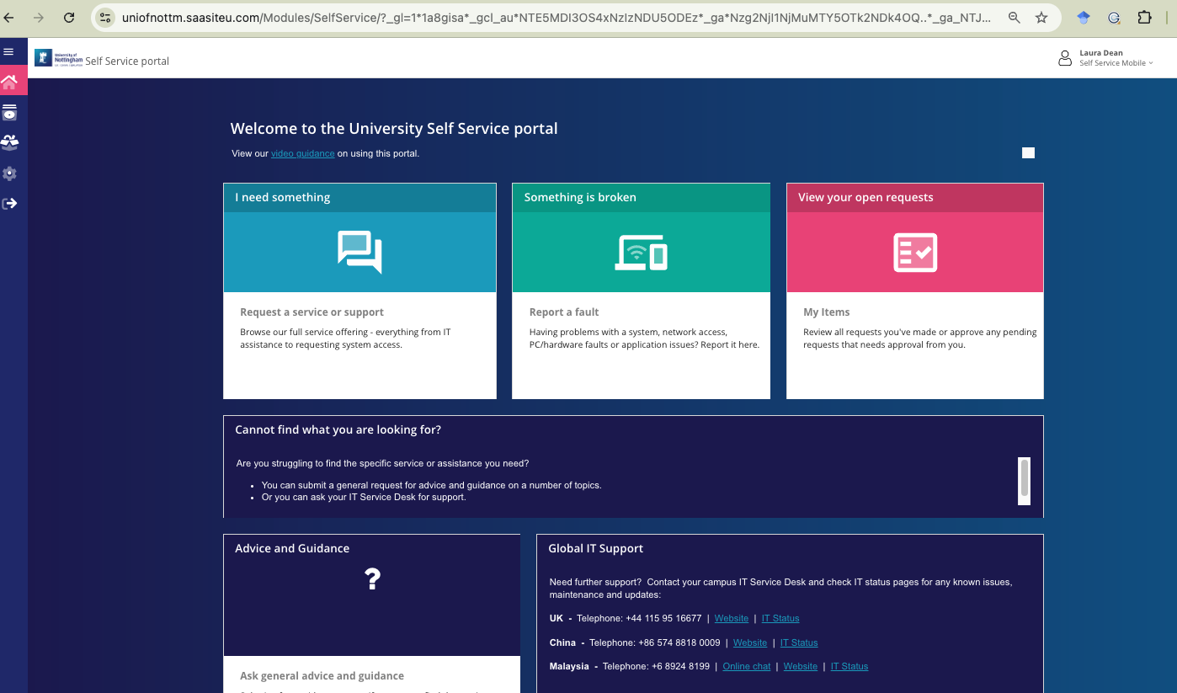
requesting new software modules
Use the IT self-service portal, like we did to request access to Ada
https://www.nottingham.ac.uk/dts/help/self-service-portal/self-service-portal.aspx
Notes:
Software on Ada must be loaded from environment modules
To search for a specific software use module avail software_name
To load modules use module load module_name
To unload use module unload module_name

Slide 34
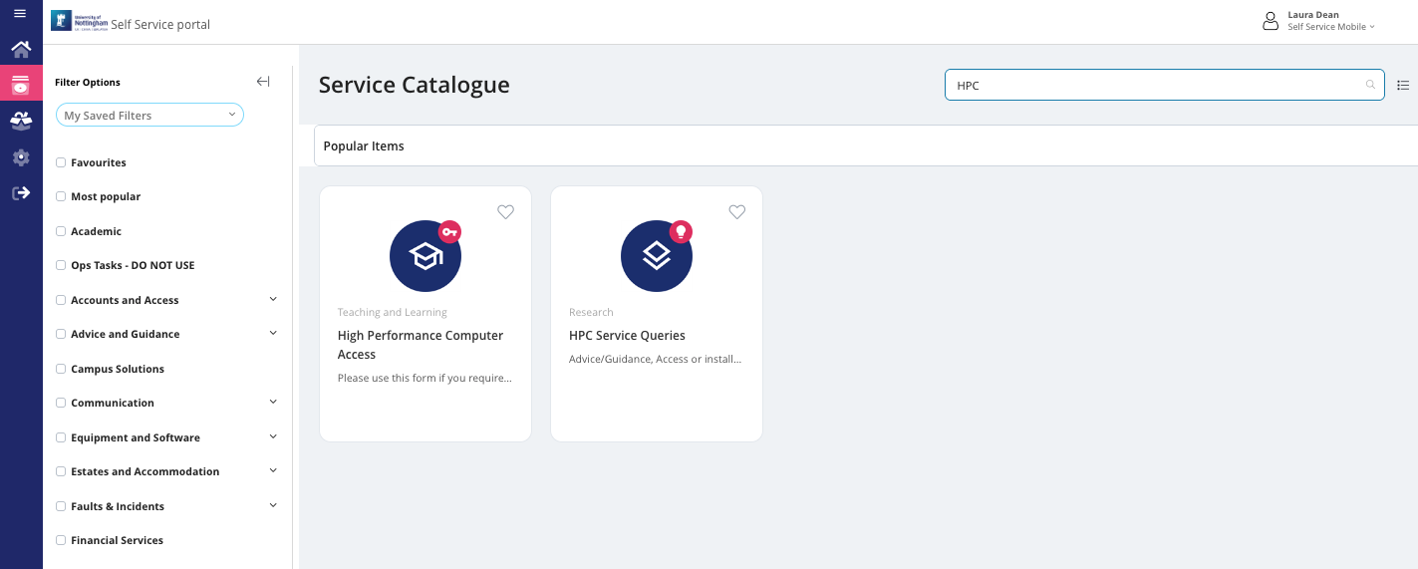
requesting new software modules
Search HPC and use the HPC Service Queries option
Notes:
Software on Ada must be loaded from environment modules
To search for a specific software use module avail software_name
To load modules use module load module_name
To unload use module unload module_name

Slide 35

UoN HPC – Ada – conda
You can install and use Conda just as you did on your own laptops
TO DOWNLOAD: > wget https://repo.anaconda.com/miniconda/Miniconda3-latest-Linux-x86_64.sh
TO INSTALL: > bash Miniconda3-latest-Linux-x86_64.sh
Say yes to everything it asks you during the install process - accept the license terms with yes and accept the default install location by pressing return
Log out of Ada and back in again
Then run the following commands:
> conda config --set auto_activate_base false
> conda config --set env_prompt '({name})'
> conda config --append channels conda-forge
> conda config --append channels bioconda
> conda deactivate
Then create environments and install software just like you have on your own laptop!

Slide 36
EXAMPLE: using conda in a job submission script
#!/bin/bash
#SBATCH --partition=defq
#SBATCH --nodes=1
#SBATCH --ntasks=1
#SBATCH --cpus-per-task=1
#SBATCH --mem=1g
#SBATCH --time=00:05:00
#SBATCH --job-name=my_job
#SBATCH --output=/gpfs01/home/mbzlld/slurm-%x-%j.out
#SBATCH --error=/gpfs01/home/mbzlld/slurm-%x-%j.err
#SBATCH --mail-type=ALL
#SBATCH --mail-user=mbzlld@exmail.nottingham.ac.uk
# source your bash profile so you can use conda
source $HOME/.bash_profile
# activate conda environment
conda activate environment_name
# do some tasks within conda environment
# deactivate conda environment
conda deactivate
Conda will not work unless you source your bash profile before you use it

Slide 37
UoN HPC – Ada – moving data - files
scp = secure copy
For copying files and directories to / from a HPC and your local machine
Always run the command from your local machine (not when you are logged in to Ada)
Syntax for copying files:
scp username@remote_address:/path/to/file/file.txt /local/path/to/write/to/
To copy a file from Ada to the current directory on your laptop:
scp ada:~/path/to/file/file.txt ./
To copy a file from the current directory on your laptop to Ada:
scp ./file.txt ada:~/path/to/dir/

Slide 38
UoN HPC – Ada – moving data - directories
scp = secure copy
For copying files and directories to / from a HPC and your local machine
Always run the command from your local machine (not when you are logged in to Ada)
Syntax for copying directories:
scp -r username@remote_address:/path/to/dir /local/path/to/write/to/
To copy a directory from Ada to the current directory on your laptop:
scp -r ada:~/path/to/file/directory ./
To copy a directory from the current directory on your laptop to Ada:
scp –r ./directory ada:~/your/file/path/

Slide 39

UoN HPC – Ada – support & information
The sharepoint site:
Commands, partitions and resources:
https://uniofnottm.sharepoint.com/sites/DigitalResearch/SitePages/Ada-Commands-Partitions-and-Resources.aspx
Software modules:
https://uniofnottm.sharepoint.com/sites/DigitalResearch/SitePages/Ada-Compute-software.aspx
The IT helpdesk: (if you need something that requires admin rights, this is your only option!)
https://www.nottingham.ac.uk/dts/help/self-service-portal/self-service-portal.aspx
Me! : laura.dean@nottingham.ac.uk or teams chat

Slide 40
UoN HPC – Ada – SLURM commands:
Check your storage:
mmlsquota -u username --block-size G dss2fs01:HOME

